Slide 1
KOKO Disaster Recovery Strategy

Slide 2
Introduction
Objectives
Business impact analysis
Risk analysis
DR strategy
DR plan
DR testing

Slide 3

Introduction
Currently KOKO Networks has no defined and documented approach for Disaster Recovery. This should define how the company will respond to a ‘disaster’ affecting its software and/or hardware systems and technology.
The operation of the business relies on a number of ‘off-the-shelf’, custom-built, and SaaS software packages - some of which are more critical than others. This landscape of technologies and systems evolved organically and subsequently the role and criticality of each piece of software or hardware may not be formally defined.
If Amazon experienced a protracted regional AWS outage (where a lot of KOKO’s systems are hosted) there would be a significant risk that key KOKO systems might not function, limiting our business’ ability to function (e.g. allow customers to top up their KOKO wallet, purchase fuel, produce and/or ship cookers, etc.). Similarly an outage by a SaaS provider (e.g. Google’s GSuite) could significantly harm KOKO.

Slide 4
Objectives
The principal objective of the disaster recovery project is to develop, test and document a well-structured and easily understood plan which will help the company recover as quickly and effectively as possible from an unforeseen disaster or emergency which interrupts information systems and business operations.
Additional objectives include the following:
The need to ensure that relevant employees fully understand their duties in implementing such a plan
The need to ensure that operational policies are adhered to within all planned activities
The need to ensure that proposed contingency arrangements are cost-effective
Disaster recovery capabilities as applicable to key customers, vendors and others

Slide 5
Business Continuity & Disaster Recovery (BCDR)
Business continuity (BC) and disaster recovery (DR) are closely related practices that support an organization's ability to remain operational after an adverse event e.g. natural disasters, cyberattacks or other malady can cause financial losses, damage the corporate brand and, and even close a business permanently.
The role of DR is to minimize the effects of outages and disruptions on business operations. DR practices enable an organization to get back on its feet after problems occur, reduce the risk of data loss and reputational harm, and improve operations while decreasing the chance of emergencies.
DR is an established function in many IT departments with respect to individual systems. However, BCDR is broader than IT, encompassing a range of considerations , including crisis management, employee safety etc. BC is therefore not in scope for this project.
Developing a DR strategy involves conducting a business impact analysis (BIA) and risk analysis as well as developing DR plans, tests, exercises and training. Planning documents also help with resource management, providing information such as employee contact lists, emergency contact lists, vendor lists, instructions for performing tests, equipment lists, and technical diagrams of systems.

Slide 6
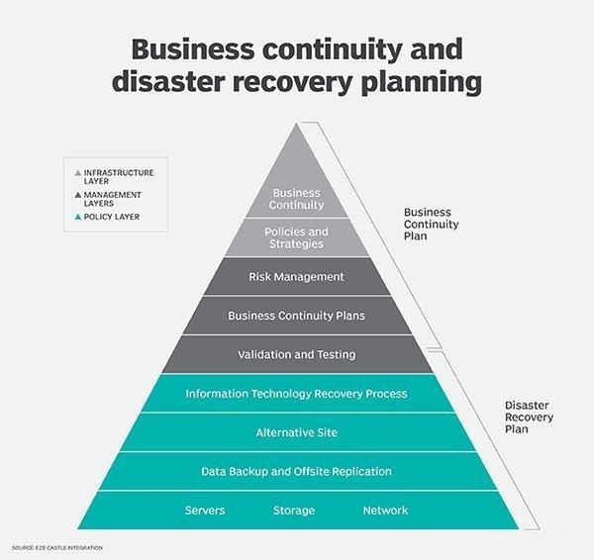
Business Continuity & Disaster Recovery (BCDR)
Business continuity (BC) and disaster recovery (DR) system:

Slide 7
Business Continuity & Disaster Recovery (BCDR)
DR planning is composed of the following steps:
Risk assessment
Business impact analysis (BIA) -
DR strategy
DR plan
Tests, exercises and training
Conducting a BIA can reveal any possible weaknesses, as well as the consequences of a disaster on various KOKO departments/user groups. The BIA report will inform KOKO of the most crucial functions and systems to prioritize in a business continuity plan.
A risk assessment identifies potential hazards to an organization, such as natural disasters, cyberattacks or technology failures. Risks can affect KOKO staff, KOKO customers, KOKO agents, KOKO operations and reputation. The assessment also details what or who a risk could harm, and the likeliness of the risks.
The BIA and risk assessment work hand in hand. The BIA provides details on potential effects to the possible disruptions outlined in the risk assessment. Both BIA and risk assessment will be crucial for developing a DR strategy/DR plan.

Slide 8
DR Approach
Developing the DR plan will start by creating the DR policy. This is the foundation for the process and will cover the scope of the DR management system, staff responsible for it, and the activities performed. The policy will also establish a common set of metrics, such as key performance indicators and key risk indicators.
The next step will be to perform a risk analysis and Business Impact Analysis (BIA). We will begin by identifying the most critical systems of KOKO Networks, and how quickly (RTOs) and to what extent they must be running after an incident (RPOs). After this, we’ll then write the step-by-step DR procedures, and finally, the documents will be tested, reviewed and updated subsequently.
In summary, the process of building the DR plan will involve the following activities:
Risk identification
Infrastructure review
Business impact analysis
Plan design
Plan implementation
Testing

Slide 9
Risk Assessment
Risk analysis is the system of identifying and analyzing potential issues that could negatively impact key business operations. This process is done in order to help organizations avoid or mitigate those risks.
Performing a risk analysis for KOKO Networks will include considering the possibility of adverse events caused by issues like server downtimes, network problems, service outages etc.
An important part of risk analysis is identifying the potential for harm from these events, as well as the likelihood that they will occur.
The purpose for conducting a risk analysis on KOKO systems is to help plan responses for technology or equipment failure or loss from adverse events, both natural and human-caused.
The risk assessment results will be used to inform the Business Impact Analysis (BIA).

Slide 10
Risk Assessment
Risk Assessment Steps:
The following steps will be followed in this assessment:
Identify the hazards: Identify any potential hazards that, if they were to occur, would negatively influence the KOKO’s ability to conduct business. Potential hazards include network outages, cyberattacks, power failure etc.
Determine vulnerable systems: Determine which systems would be negatively influenced if the risk came to fruition. These can include critical infrastructure, IT systems, business operations etc.
Evaluate the risks and develop control measures: Identify how hazards will impact KOKO systems and the measures that can be put into place to minimize or eliminate the effect of these hazards. Potential hazards include system outages, notification system failure etc.
Document the findings: Document the risk assessment findings. This should include details on potential hazards, their associated risks and plans to prevent the hazards.

Slide 11
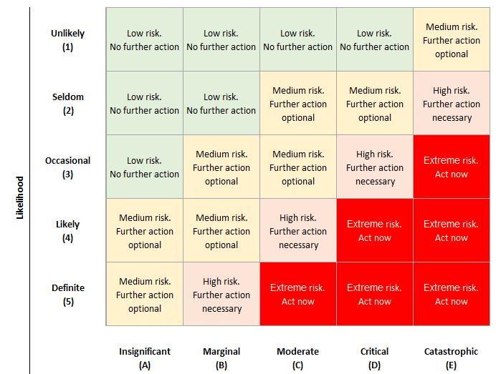
Risk Assessment
Risk Assessment Matrix:
[ Risk Assessment Form ]

Slide 12
Business Impact Analysis (BIA)
A business impact analysis (BIA) is a process that analyzes mission-critical business functions and identifies and quantifies the potential impact a loss of those functions, e.g. operational or financial, may have on the organization, KOKO Networks in this case.
The result of conducting the BIA process is a business impact analysis report, which describes the potential risks specific to KOKO Networks.
The BIA will serve as one of the starting points for forming the DR strategy. Through the BIA, we’ll be able to examine each KOKO system’s recovery time objectives (RTOs) and recovery point objectives (RPOs), which are the maximum amount of time it can take to recover from an incident and the extent of data it can afford to lose, respectively.
The BIA for this project will be limited in scope. It will modified to concentrate on the technical aspects of KOKO systems, and evaluate their impact on other systems, as well as KOKO business operations.
[ KOKO Systems BIA questionnaires ]

Slide 13
Business Impact Analysis (BIA)
KOKO BIA questionnaire template:
System name: Enter the system's name.
System owner: Enter the name of the organization running the system, e.g. KOKO Networks, AWS.
Business operations: Name the KOKO business units the system supports, e.g. network operations, fuel operations.
System activities: Describe the principal activities the system performs, e.g. processing payments, sending SMS.
Priority ranking: Enter a number here for subjective ranking of the system and it's importance to KOKO businesses (Low -1, Medium - 2, High - 3, Critical - 4).
System depends on: Enter names of other systems the system depends on for normal operations.
System required by: Enter names of other systems that depend on the system for normal operations.
Recovery time objective (RTO): Enter a time frame in hours e.g. 1 hour, 24 hours; it describes the time a parent system has to return to business almost as usual following a disruption.
Recovery point objective (RPO): Enter a time frame in hours e.g. 1 hour, 24 hours; this is a point in time marking an acceptable loss of parent system data following a disruption.
Recovery strategy: Enter specific actions taken to recover to a business almost as usual state.

Slide 14
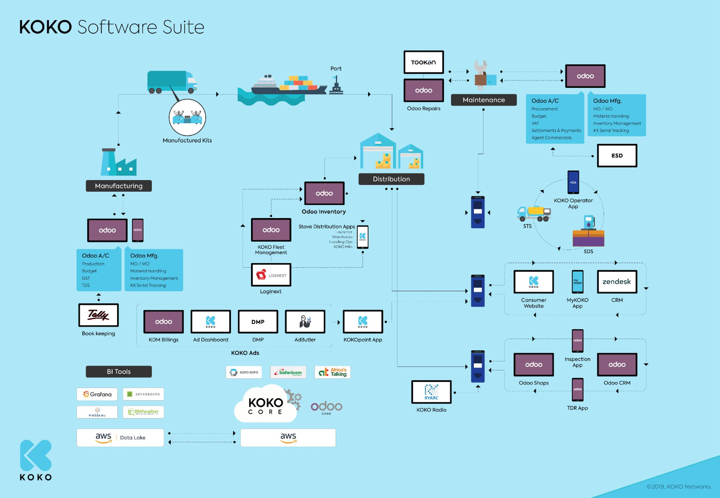
KOKO Systems Map
Maintenance
Manufacturing
KOKO Ads
Distribution
BI Tools

Slide 15
KOKO Systems Map
KOKO systems are technology related infrastructure that support KOKO business operations.
They support the following business operations:
Network Operations
Fuel Operations
Cooker Operations
Customer Sales
Customer Care
Agent Network

Slide 16
KOKO Systems
There are 4 types of KOKO systems based on their deployment location:
Cloud systems
Field systems
Mobile systems
Vendor systems

Slide 17
Cloud Systems
Cloud systems are hosted on Cloud based servers. KOKO cloud systems are hosted on Amazon Web Services (AWS).
They include the following:
KOKO Core
KOKO ERP
KOKO Message Brokers
Notification Service
KOKO Ads Services
KOKO Consumer website
Agent Application
Vendor Systems (Vendor system: out of scope):
Calltronics (Vendor)
Safaricom
Africa’s Talking
Freshdesk
Zendesk
AWS Services: EC2, RDS (Primary & Read replicas), Lambda, S3 Buckets, Glue & Athena, Route 53, ElastiCache, Parameter Store

Slide 18
Field Systems
Field based systems are software running on KOKO hardware.
They include the following:
SDS application
STS application
KOKO Operator Application (KOA)
KP application
KOKO supply chain applications

Slide 19
Mobile Systems
Field based systems are software running on customer facing mobile devices e.g. phones or tablets.
They include the following:
myKOKO application

Slide 20
DR Plan
The Disaster Recovery (DR) plan is a document that defines the KOKO systems DR recovery process and procedures required to return the company operations to normal after a disaster event. The template is attached in the link below:
[ SYSTEMS DR PLAN ]

Slide 21
Summary of KOKO Systems By Criticality
Coming soon...

Slide 22
KOKO DR Policy
Coming soon...

Slide 23
KOKO DR Strategy
Coming soon...

Slide 24
KOKO DR Plan
Coming soon...

Slide 25
k.nyawallow@kokonetworks.com

